Slide 1
A New Day for Microsoft
Presented by Michael Pozo

Slide 2
The Business Question Microsoft is considering entering into the movie space and has asked my team what they should be thinking about as they make plans to enter the market

Slide 3
My Approach
Select the best time to release movies in theaters based on worldwide box office sales
Uncover the movie genres that performed the best during these time periods
Identify the best directors in these genres based on reviews and profitability as priority targets

Slide 4
The Data
IMDB
Movie Ratings
Director Names
Genres
Movie Budgets
Box Office Sales
Release Dates

Slide 5
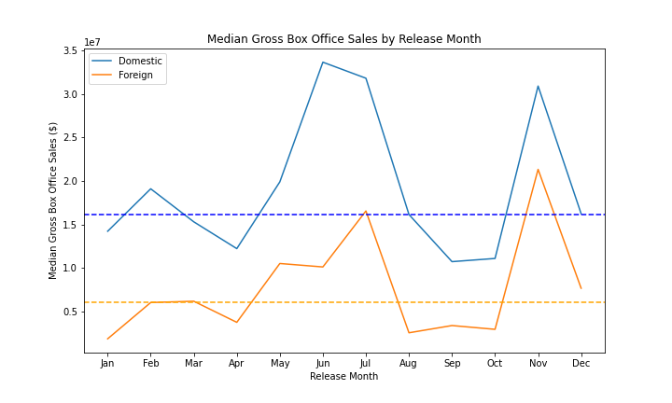
Target an Early Summer or November Release Date
Box office sales peak in June, July and November
Trend holds true for domestic and foreign markets
Recommend targeting peak months to reach the largest audience and maximize sales

Slide 6
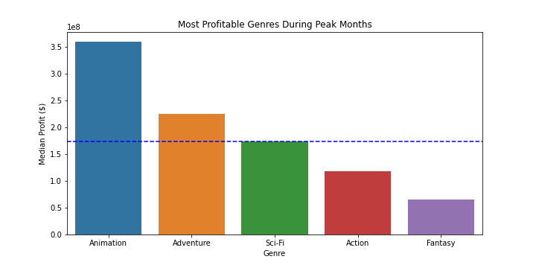
Invest in the Animation Genre
106% Greater Profit than Median
Median Profit

Slide 7


Animation Director Shortlist
The following animation directors were ranked in the top 10 in both profit and ROI and should be priority targets when choosing a director (minimum 2 productions in last 10 years)
Director
Pierre Coffin
Lee Unkrich
Dean DeBlois
Gennedy Tartakovsky
Tom McGrath
Chris Sanders
Mike Thurmeier
Raja Gosnell
Carlos Saldanha
Mike Mitchell
Pierre Coffin
Director of Despicable Me and Minions Franchises
Most Profitable and ROI Positive Director
Mike Thurmeier
Director of Ice Age Franchise
Most Profitable and ROI Positive Director

